Slide 1
Project 18-Topic Modelling
By-Team 18
Akhil Singh, Ishan Bansal, Vikrant Goyal, Paawan Gupta

Slide 2
Supervised Learning
Input is a pair consisting of an input object and a desired output value.
It learns a function to map input object to the desired output value which can be used in predicting the output values for new input object.
Examples: Based on past information about spams, filtering out a new incoming email into Inbox (normal) or Junk folder (Spam), classification of objects etc.

Slide 3
Unsupervised Learning
Unsupervised learning studies how systems can learn to represent particular input patterns in a way that reflects the statistical structure of the overall collection of input patterns.
There are no explicit target outputs rather the unsupervised learner brings to bear prior biases as to what aspects of the structure of the input should be captured in the output.
It is often easier to obtain unlabeled data from a lab instrument or a computer than labeled data, which can require human intervention.
Examples: Clustering, PCA etc.

Slide 4
Topic Modelling
Motivation
Large unstructured collection of documents.
Discover set of topics that generated the documents.
Annotate documents with topics and it’s topic distributions.

Slide 5
Latent Dirichlet allocation (LDA)

Slide 6
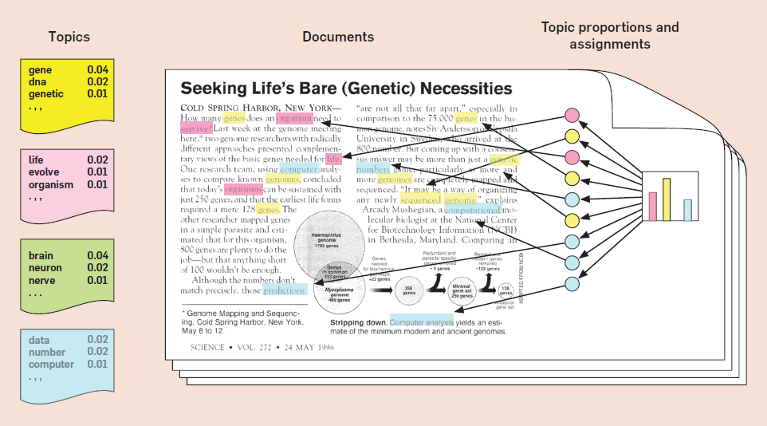
Intuition behind LDA - Generative model

Slide 7
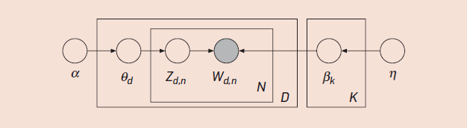
Model of LDA
Each node is a random variable and is labeled according to its role in the generative process.
The topics are b_{1:k}, where each b_{k} is a distribution over the vocabulary.
𝛳_{d} is the topic proportion for the d^{th} document.
Z_{d} is the topic assignment for the d^{th} document.
W_{d} is the observed word for d^{th} document.

Slide 8
Dirichlet Priors α and β
α is a force on the topic combinations.
Low α forces to pick for each doc a topic distribution which favors few topics.
High α allows documents to have similar, smooth topic proportions.
β is a force on the word combinations.
Low β forces each topic to favors few words.
High β allows topics to be less distinct.

Slide 9

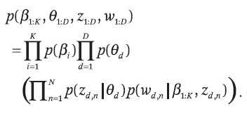
Posterior Probability for LDA
p(𝛽_{1:k},𝜃_{1:D},z_{1:D}|w_{1:D}) =
Where,

Slide 10
Steps Followed
Data Preprocessing:
Dataset used: bbc news, bbc sports
Various NLP preprocessing techniques like removing stop words,punctuation marks were applied to get a cleaned corpus.
Words with POS tags as NN,NNP and NNS would be the only one that contribute to find good topic distributions.
Used nltk tokenizer and stemmer(Porter’s algorithm) to get a clean unbiased list of words.

Slide 11
Steps Followed...Continued
Implementation of the LDA model:
1)Initialized the topic assignment matrix with random topics and populated the word-topic matrix and document-topic matrix according to this random assignments.
2)The further process follows the Expectation-Maximization algorithm in which we iteratively estimate the new probabilities with this initial matrices and then change each of the matrices according to the new probabilities calculated in the expectation step and used Gibbs sampling too.

Slide 12
Steps Followed...Continued
3) Then we finally find the word probability distribution in each topic and the topic distribution in each document.
Implementation of Text Classification(Application of LDA):
Used the topic distribution for each document as its feature vector and did document classification with the help of SVM.

Slide 13
Results and Simulations

Slide 14
No of Topics | Labels | Accuracy
2 | Sports,Entertainment | 64.5%
3 | Tennis,Athletic,Cricket | 49.6%
3 | Tennis,Football,Rugby | 44.4%

Slide 15
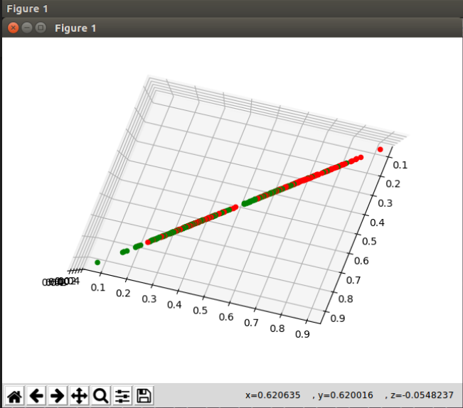
Topics - 2
Labels - Sports,Entertainment
Accuracy - 64.5%

Slide 16
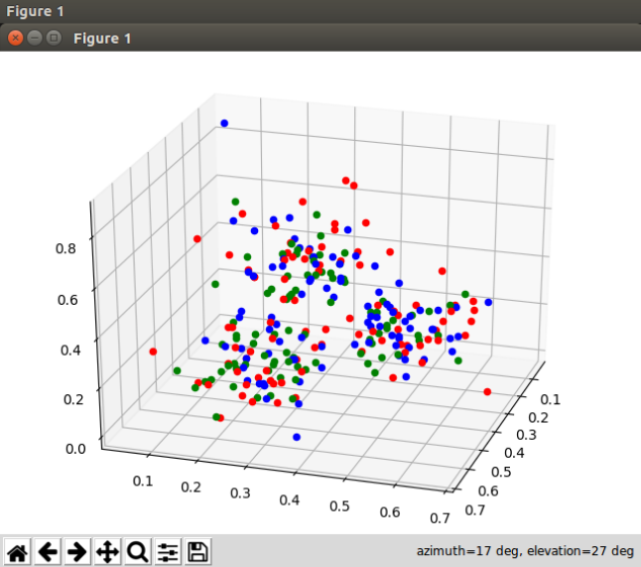
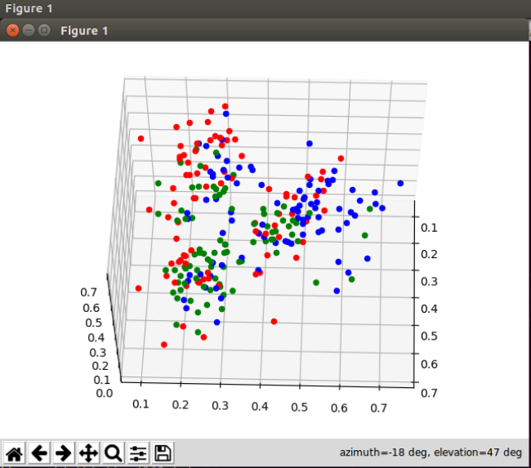
Topics - 3
Labels - Tennis,Athletic,Cricket
Accuracy - 49.6%

Slide 17
Topics - 3
Labels - Tennis,Football,Rugby
Accuracy - 44.4%

Slide 18
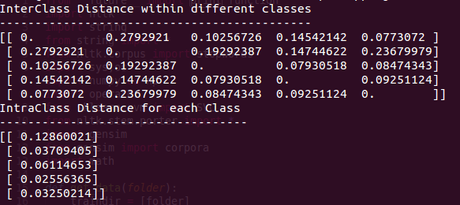
Interclass and Intraclass Distances
Dataset used : BBC sports

Slide 19
Milestones achieved
Successfully implemented topic modelling with LDA from scratch and also applied Gibbs sampling to the same.
For larger number of topics, we also tried using SVD for dimensionality reduction to extract the important features to run classifier on the same.
Used the topic distribution of each document as its feature vector and used these feature vectors to do document classification using SVM resulting in a good accuracy.
We also evaluated our LDA model by calculating interclass and intraclass separation.
We also implemented LSA(Latent Semantic Analysis) model using SVD and k-means clustering to find the similarity of word which is an another approach to do topic modelling.

Slide 20
Thanks...

